Slide 1

The @Home Software Team

Slide 2
The Software Problem
1. We can build robots
2.They don’t do anything useful

Slide 3


The Software Solution
Put this
Into this

Slide 4
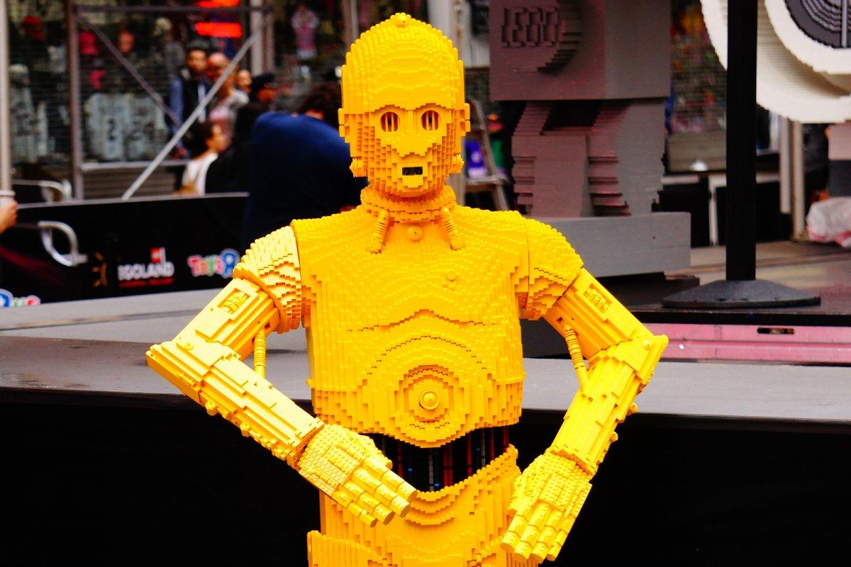
How?
Build it piece by piece

Slide 5
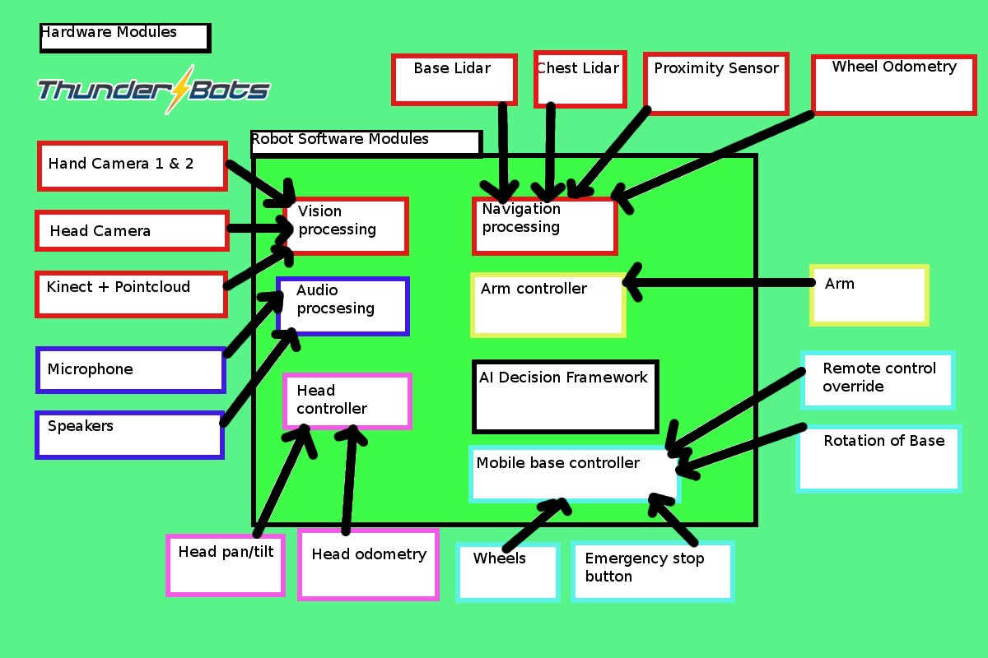
The Architecture
The pieces we need have been invented

Slide 6
Take your piece
1. Pick your favourite project
2. It’s part of a freaking robot brain

Slide 7
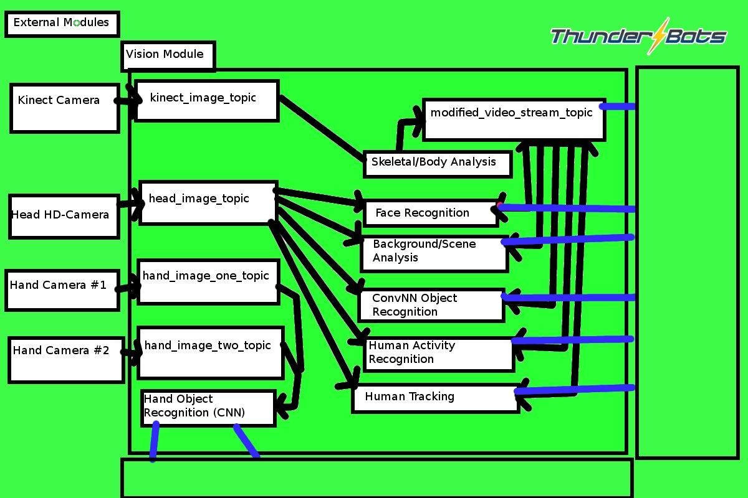
Example Project Piece
The Robotic Vision System

Slide 8
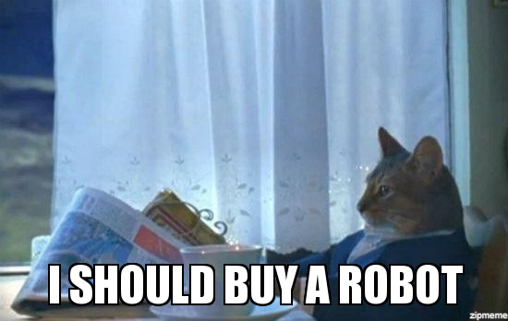
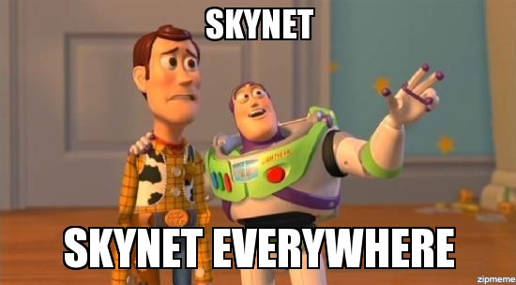
Our Goals
When people see our robot..

Slide 9
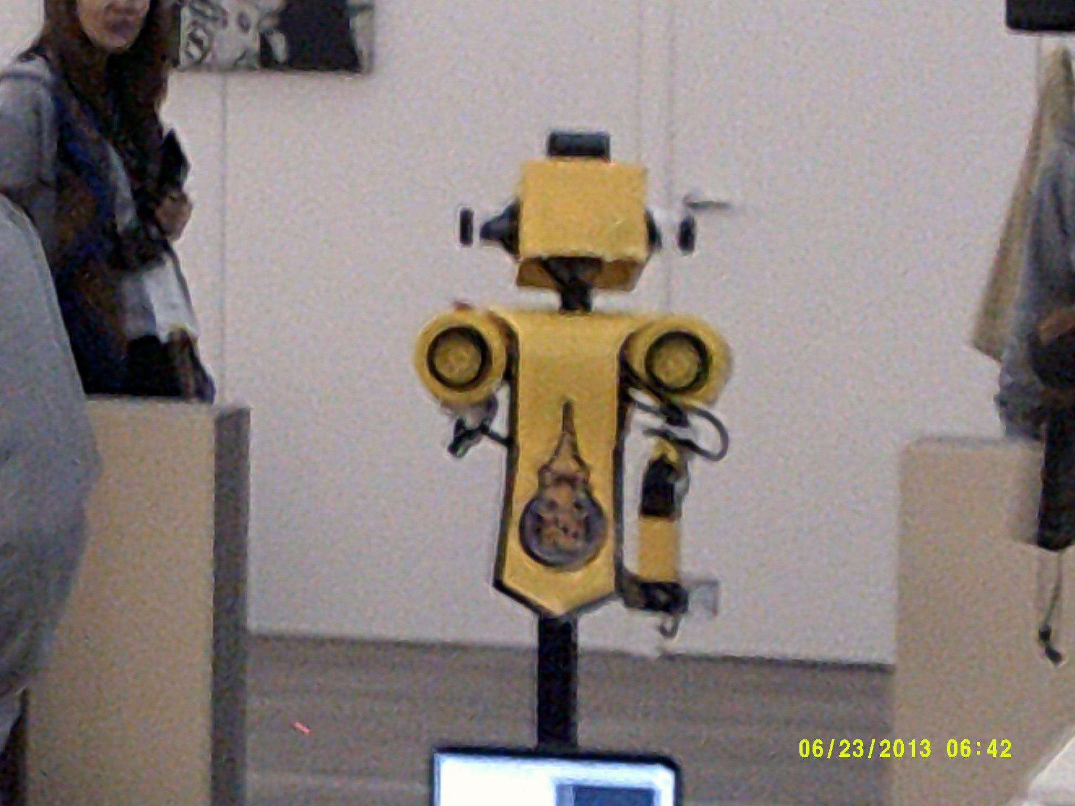
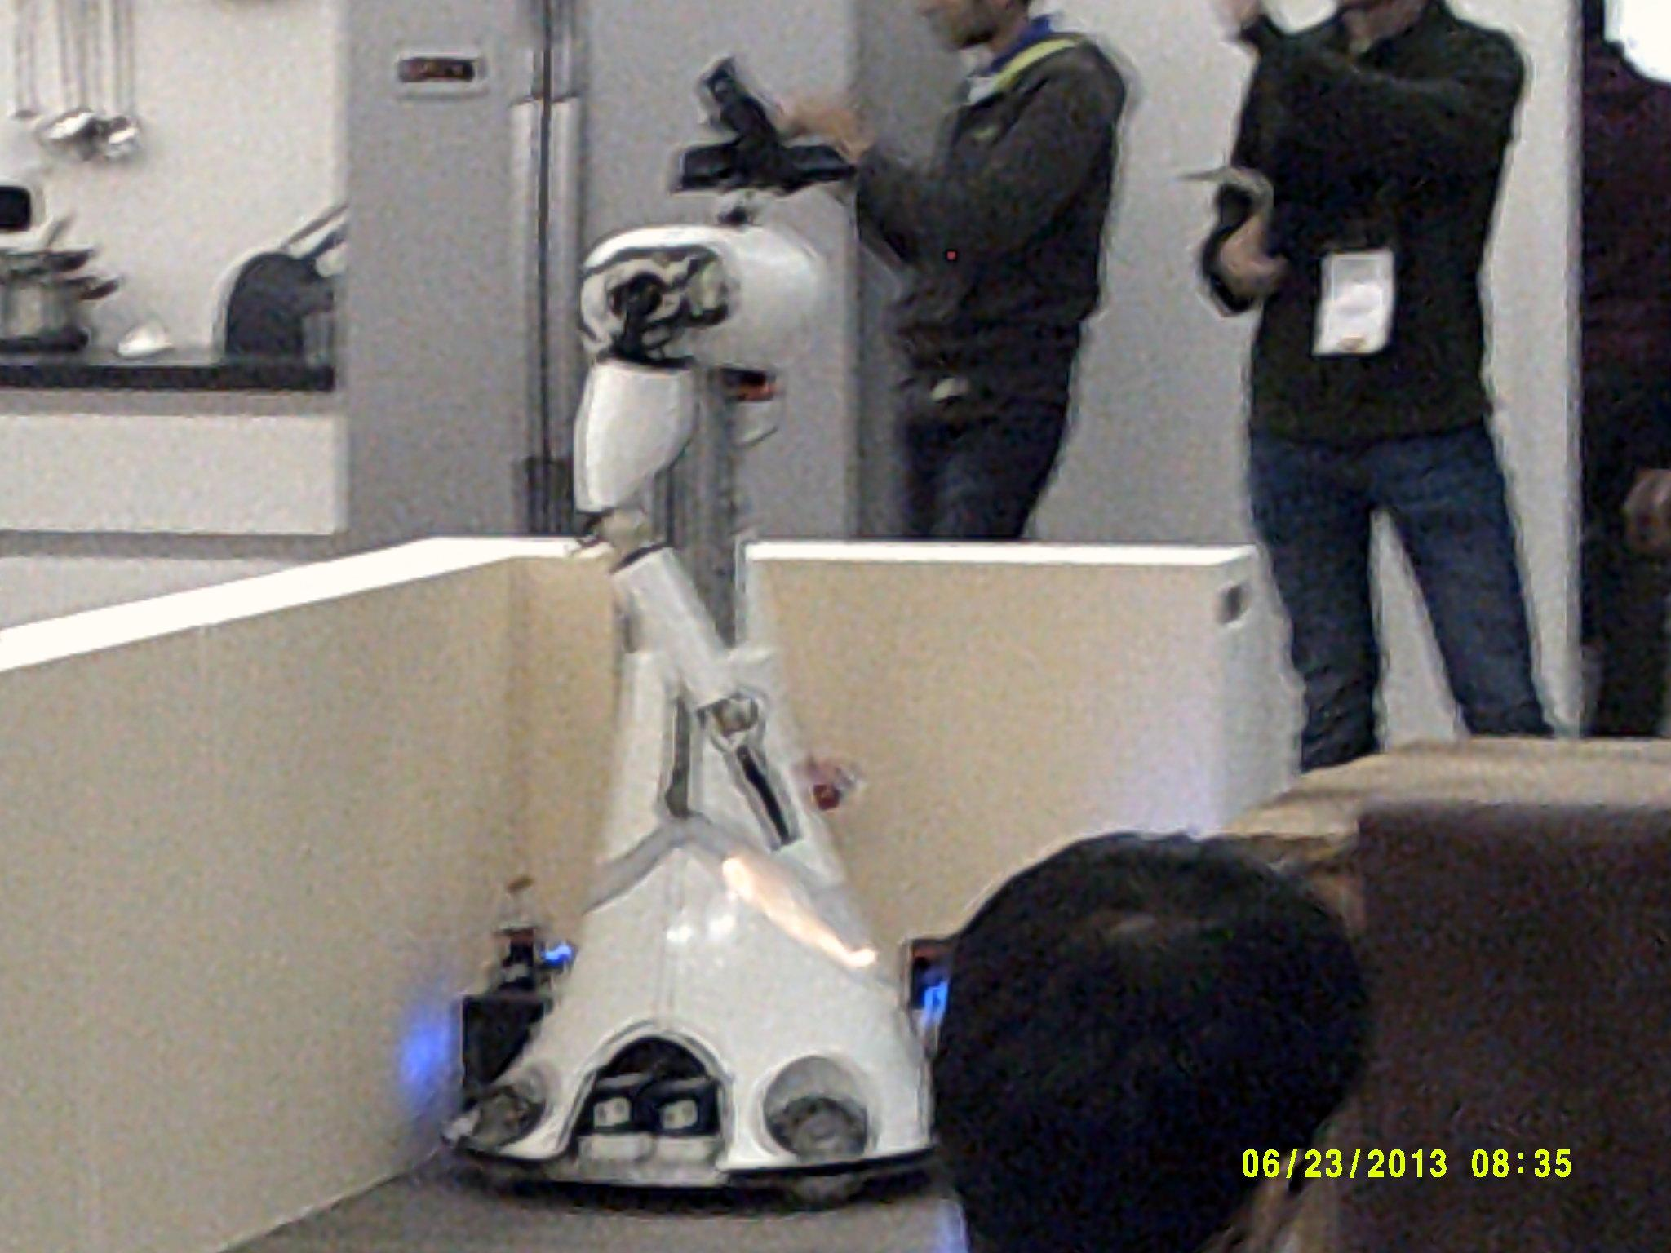
Our Goals
Compete in RoboCup 2014

Slide 10
Our Competition
Doesn’t matter.
Has tons of money.
Thinks they’re better than us.

Slide 11
What now?
1. Pick a project by next Saturday (tell me) 2. Get started on the new member kit 3. Help eachother help eachother.Admin Team: Alannah: alannah.yip@gmail.com Software Team: Lili’s Email: lilimeng1013@gmail.com Mike’s Email: mmoritsugu@gmail.com My email: noobaca2@gmail.com (Devon)

